Slide 1

How Can a Team Become Better at Offensive Efficiency to Increase its Chances of Winning Games for NCAA Division I Basketball Programs?
Armando Zapata

Slide 2




Objectives
This Photo by Unknown Author is licensed under CC BY-SA
Create a prescriptive model to aid college basketball coaches implement analytics-driven strategies to increase probability of winning games.
Incorporate advanced statistics on a per possession basis.
Use a combination of modest statistical methods with informative data to increase model’s accuracy.
Develop two analyses that could serve a stepping stone for further research and applications in sports analytics.

Slide 3

What is this project?
Prescriptive model containing 2 analyses:
1- Classification Tree
2- Support Vector Machine (SVM)
In this project, a prescription will be provided based on in-game statistics that could help coaches increase offensive efficiency.

Slide 4


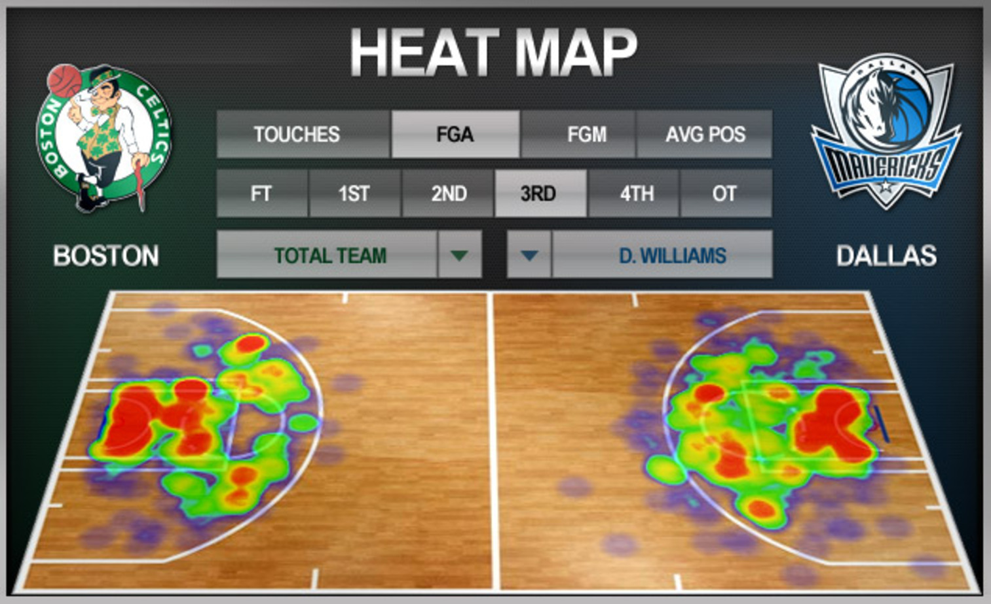
Where?

Slide 5



When can you use this model?
The data is comprised of advanced statistics for the NCAA Men’s Basketball Programs.

Slide 6



Why is this event such a BIG DEAL!

Slide 7
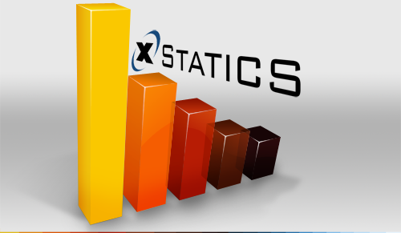
Why is this project important?
Use of advanced in-game related statistics.
Blend of modest statistical methods + informative data = accuracy

Slide 8


The Data
Adjusted Offensive Efficiency
Adjusted Defensive Efficiency
Adjusted Tempo
SOS Difference
Location
Offensive Rebound Differential
Defensive Rebound Differential
Turnover Differential
3-Point Reliance
True Shooting %
True Shooting % Allowed
Block Differential
This Photo by Unknown Author is licensed under CC BY-SA-NC
This Photo by Unknown Author is licensed under CC BY

Slide 9
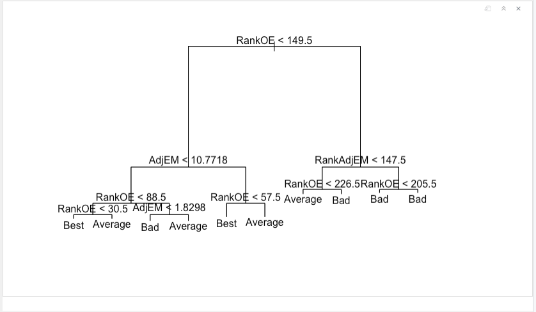
Data Processing

Slide 10
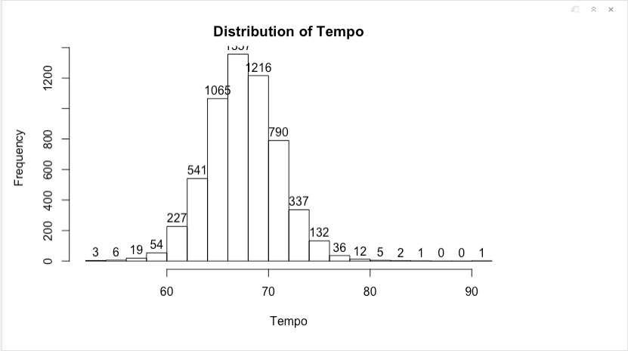
Data Processing

Slide 11
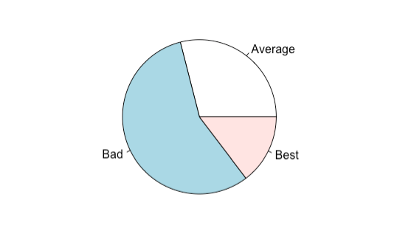
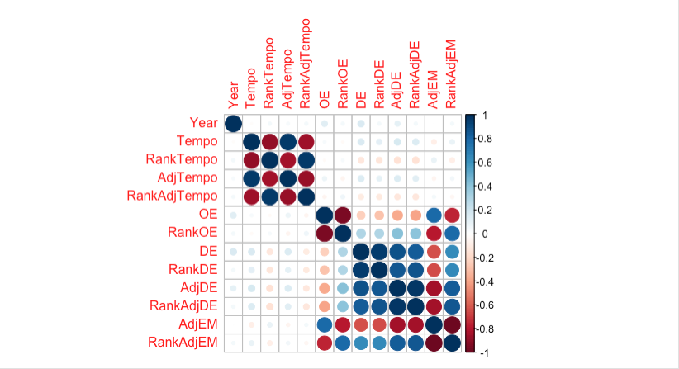
Data Description

Slide 12

Conclusion
Old business models will not survives without adopting new and advanced analytic tools.
Combination of modest statistical methods and informative data, along with luck and skills, someone will crack the code!!
Big data is changing business-decision across industries.

